Slide 1
Функциональная читательская грамотность на уроках английского языка
Данилина Елена Аркадьевна
Учитель английского языка
Яйлинская ООШ

Slide 2
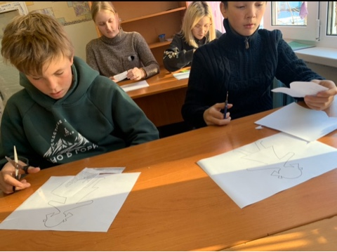
Целью обучения иностранному языку является формирование навыков свободного общения и практического применения знаний.

Slide 3
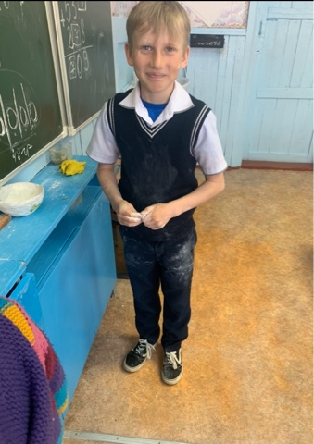
Поскольку одной из главных составляющих преподавания иностранного языка является заинтересованность обучающихся, на уроках при работе с текстом можно использовать современную педагогическую технологию, которая сделает урок интересным.

Slide 4
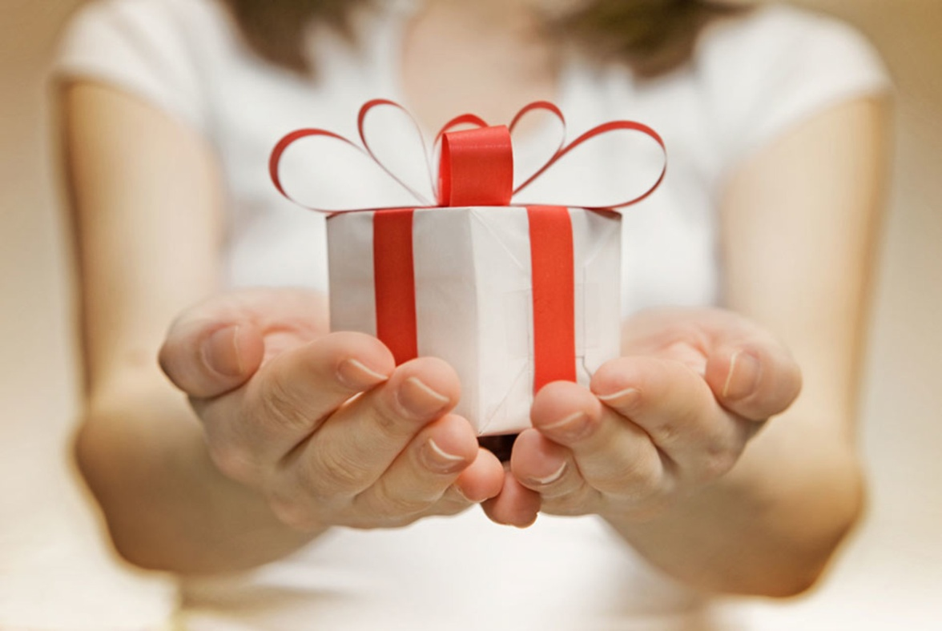
Прием «Сюрприз»
“Come to the teacher and tell her what mark you had for the dictation in Russian and see what happens.”

Slide 5
Прием «Ошибка»
Tornadoes are the most violent of all storms. Nobody can predict what they might do. Tornadoes destroy houses, carry away cars and telephone boxes. Tornadoes consist of very strong winds. They can reach speeds of up to 320 kilometres an hour. That is why they are so dangerous. In Russia during one tornado, people saw money falling from the sky. At least a thousand coins fell from the clouds. The wind had removed the earth from some buried treasure and picked up the coins. Tornadoes occur throughout the world, but mostly in the United States. The central states of the country have probably more tornadoes than any other place in the world. Tornadoes occur in the spring. Find the text about tornadoes in the student’s book, write the number of the page in your notebook and show it to the teacher. A hot day in the afternoon or in the early evening is the most likely time for this dangerous storm.

Slide 6
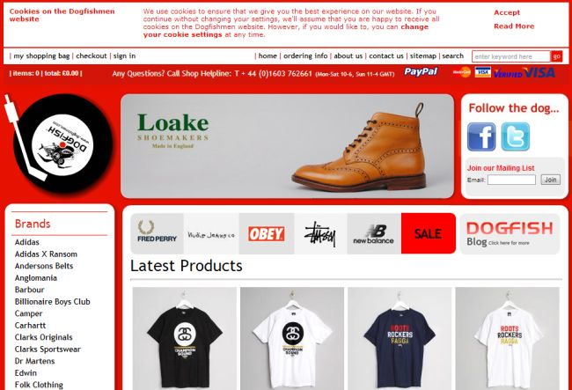
Работа С Англоязычными сайтами
You want to buy a birthday present for your friend.

Slide 7
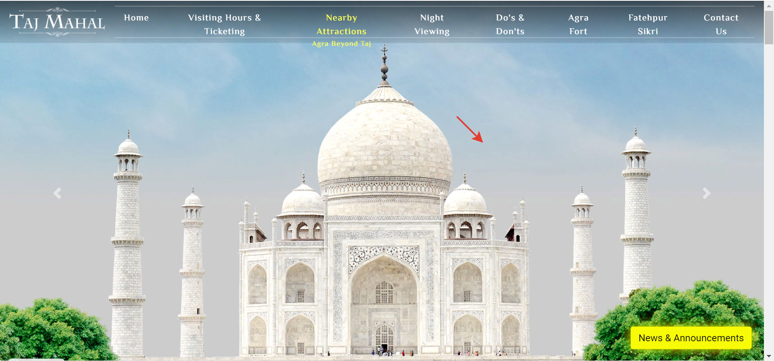
Прием – создание кластера
Это наглядный способ представления информации, когда в центре записано понятие, от которого лучами отходят другие связанные понятия. Такая карта-опора поможет ученику пересказать текст.

Slide 8
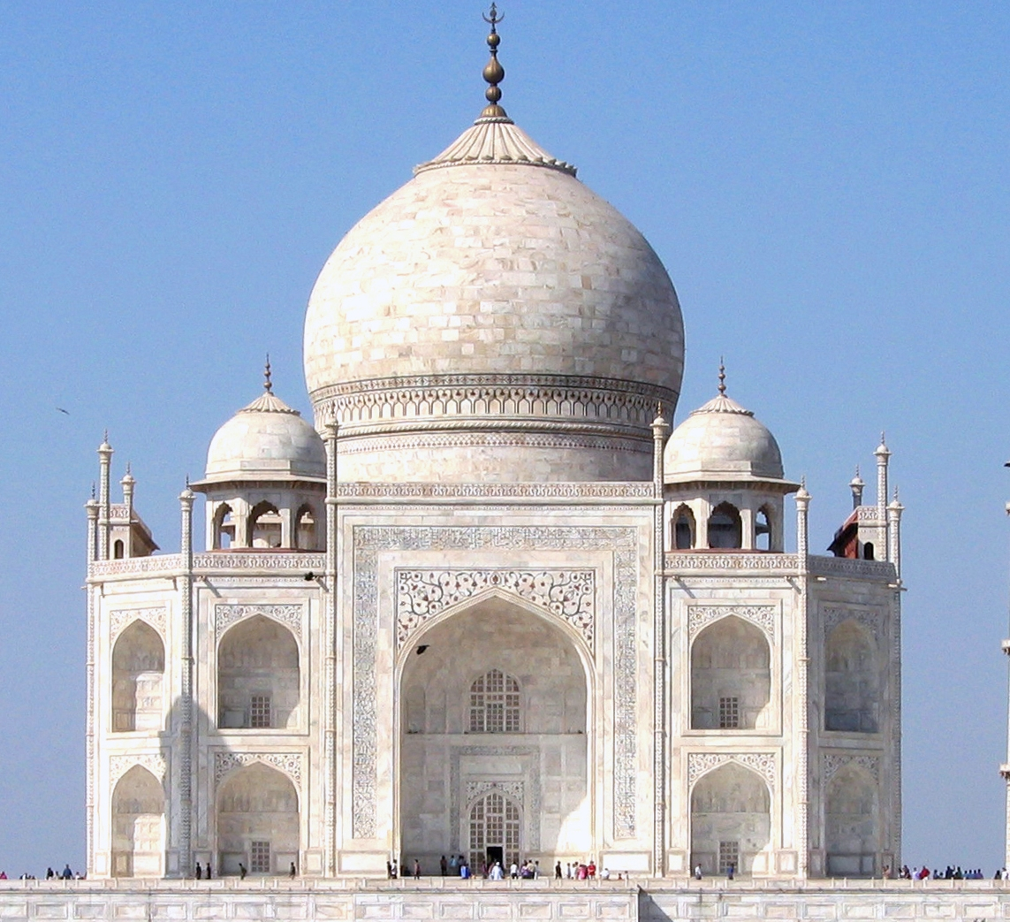

Slide 9
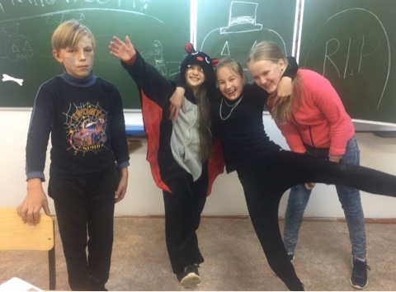
Act it out
The three little pigs The three little pigs are brothers. They are going into the forest. They want to build three houses. "Let’s build our houses here," says the first little pig, Percy. "Yes," says the second little pig, Peter. "That’s a good idea," says the third little pig, Patrick. The first little pig, Percy, gets some straw and he starts to build a house of straw. He sings, "Hum de hum, dum de dum, hee de dum, dee de hum," when he works. The second little pig, Peter, gets some wood and he starts to build a house of wood. He sings, "Hum de hum, dum de dum, hee de dum, dee de hum," when he works. The third pig, Patrick, is very clever. He gets some bricks and he starts to build a house of bricks. He sings, "Hum de hum, dum de dum, hee de dum, dee de hum," when he works. Now all the houses are ready. The three little pigs make a fence and they paint it red.

Slide 10
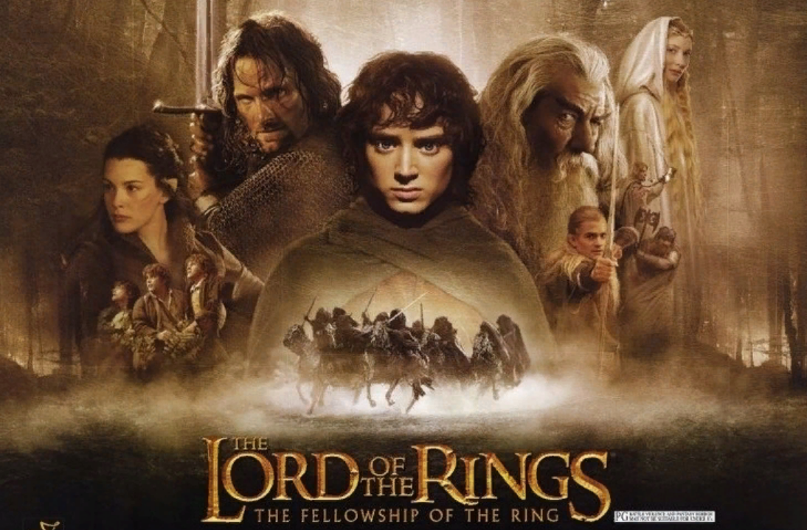
Выход за пределы
The film is set in Middle-earth – a land where such “goodly” races as hobbits, elves, dwarfs and men live. Since the ancient times they have warred with orcs, goblins and trolls. At the beginning of the film we learn about the One Ring – a powerful weapon created by the Dark Lord Sauron – which was occasionally found by Bilbo Baggins, the hobbit.
On his 111th birthday Bilbo had a great party, after which he suddenly departed and left his young cousin Frodo all his belongings, including the magic ring.
A few years later Gandalf, the wizard, visits Frodo to tell him the truth about the ring. A short time after that Frodo and three of his friends leave Shire. They are followed by the Black Riders, who are searching for Frodo and the Ring. On their way they meet a new friend Aragorn.

Slide 11
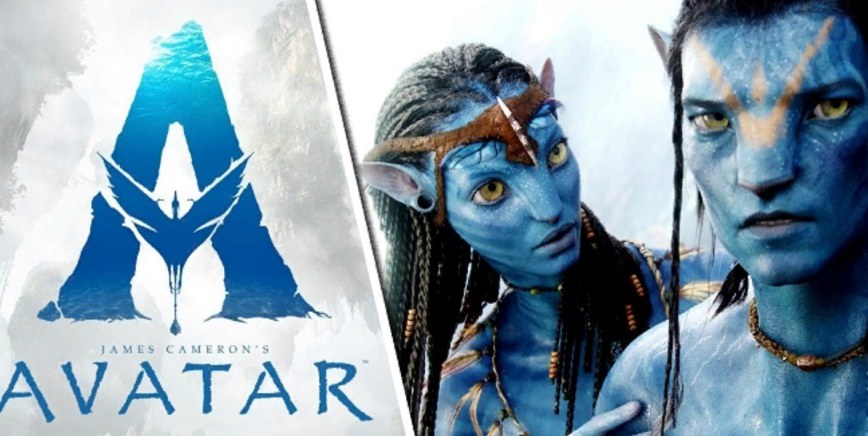
The Review on the Film «Avatar» by James Cameron
The main film of the year 2009 is «Avatar» by James Cameron, the producer of such films as «Terminator», «Titanic», «The Strangers». This film ranks with above-mentioned world-famous films and probably belongs to the science-fiction genre.
The action of the film is set on the planet Pandora in the year of 3000. The plot is rather simple: the super hero Avatar is to save the alien planet and to fulfill this mission he struggles with a lot of difficulties.

Slide 12
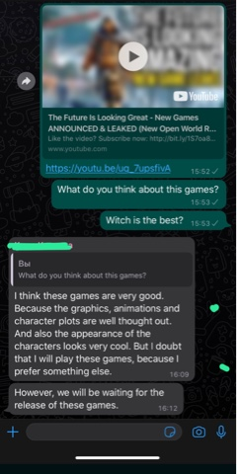
Группа в Месенджере

Slide 13
конкурс фг\Конкурс функциональная грамотность. Видеоролик Данилиной Елены Аркадьевны..mp4

Slide 14
Спасибо за внимание!

